Slide 1
HOW START TO TEST YOUR APPLICATION IF YOU DON’T HAVE SECURITY SPECIALIST
Alice Miller
OWASP DNIPRO 27.04.2018

Slide 2






Who am I?
@alice_kaifat
alice.bizarius@gmail.com

Slide 3

How can I start?

Slide 4
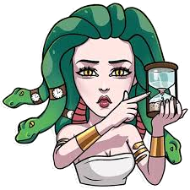

How can I start?
You need to decide and understand

Slide 5
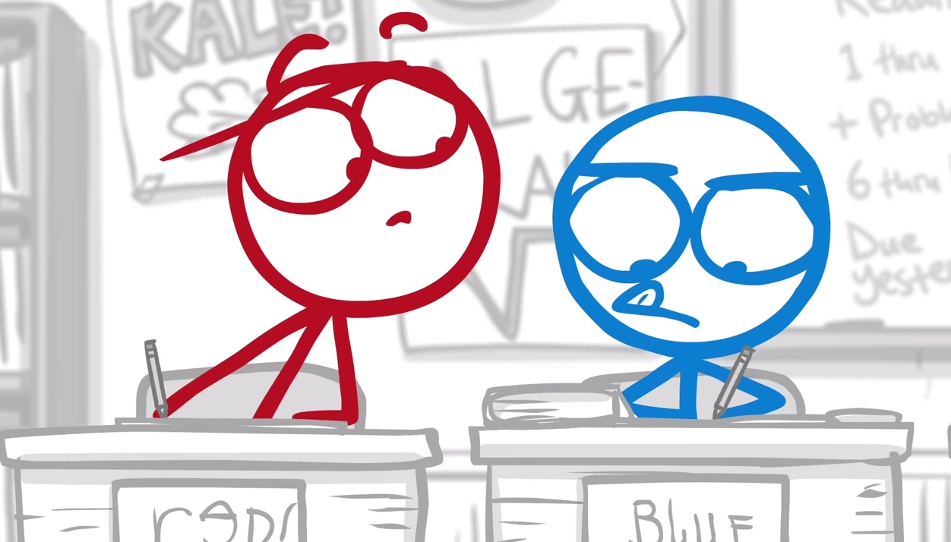
How can I start?
You need to decide and understand
Creating Testing Strategies

Slide 6

How can I start?
You need to decide and understand
Creating Testing Strategies
Build a Testing System

Slide 7

How can I start?
You need to decide and understand
Creating Testing Strategies
Build a Testing System
DO IT!

Slide 8






Slide 9

Think like a hacker

Slide 10
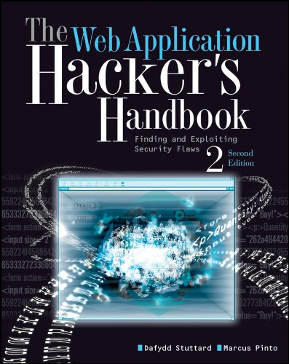

Slide 11
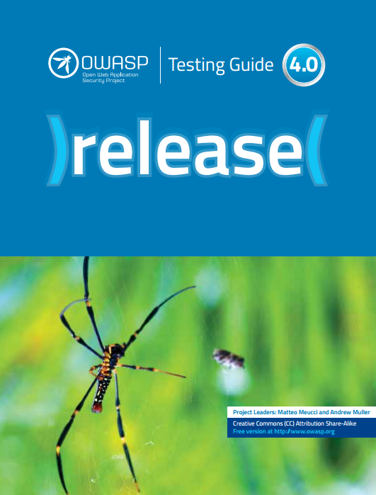

Slide 12
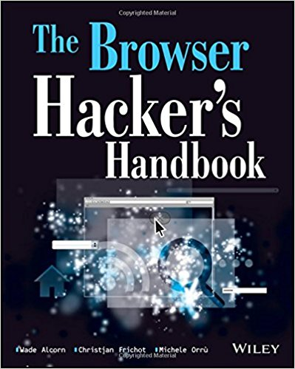

Slide 13


Slide 14


Slide 15
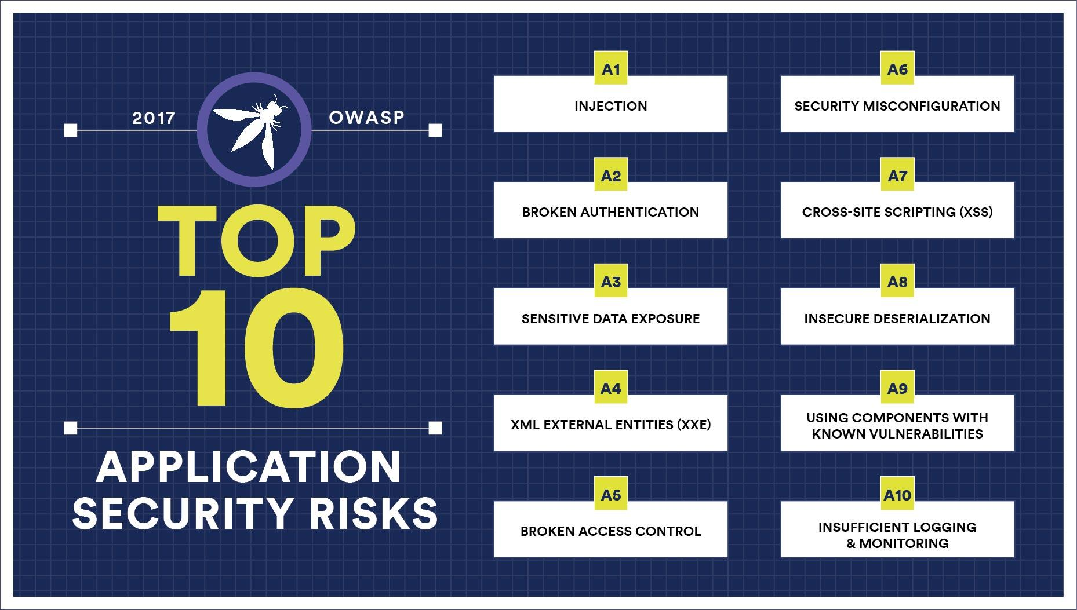

Slide 16


Tips
Don’t test in production environment

Slide 17

Tips
Don’t test in production environment
Use the actual environment

Slide 18

Tips
Don’t test in production environment
Use the actual environment
Choose your own toolkit

Slide 19

Tips
Don’t test in production environment
Use the actual environment
Choose your own toolkit
Testing Outside the Box

Slide 20

Tips
https://www.owasp.org/index.php/Category:OWASP_WebGoat_Project

Slide 21

Tips
https://www.owasp.org/index.php/OWASP_Security_Shepherd

Slide 22


Resources
23 Hacking Sites, CTFs and Wargames To Practice
Your Hacking Skills https://hackerlists.com/hacking-sites/amp/
SecurityTube http://www.securitytube.net/
Adam Doupe https://www.youtube.com/channel/UCWA6pfcx4Ok4xsIA7Mkr39w

Slide 23
Questions?
@alice_kaifat
alice.bizarius@gmail.com

